Slide 1
How I learned to use the computer efficiently (Mostly by using the keyboard)
ram@rachum.com
https://ram.rachum.com

Slide 2

About me
Ram Rachum
Python/Django developer for 6 years
Software development services: https://chipmunkdev.com
I do Python tutorials! If your company needs someone to help improve the Python chops of your team, talk to me.
GitHub: https://github.com/cool-RR
PyWeb-IL organizer ☺

Slide 3
What do I mean by “Use the computer efficiently”?
Doing everyday computer tasks quickly and with minimal amount of finger/hand/arm movement. Some example tasks:
Typing text
Browsing the web
Navigating menus
Writing code
Starting programs
Controlling your debugger

Slide 4
More examples of common tasks:
Pressing buttons in GUIs
Starting SSH sessions
Starting local terminals
Switching to a window
Pasting common snippets of text
Closing a non-responding program
Maximizing / minimizing / restoring / moving windows
Creating random passwords
Manipulating the clipboard
Renaming a file
Changing sound volume
Playing/pausing a song

Slide 5
I’ll talk about my personal story of learning to use computers efficiently.
I’ll talk about why nobody talks about using computers efficiently.
And then I’ll talk about how to use computers efficiently.

Slide 6
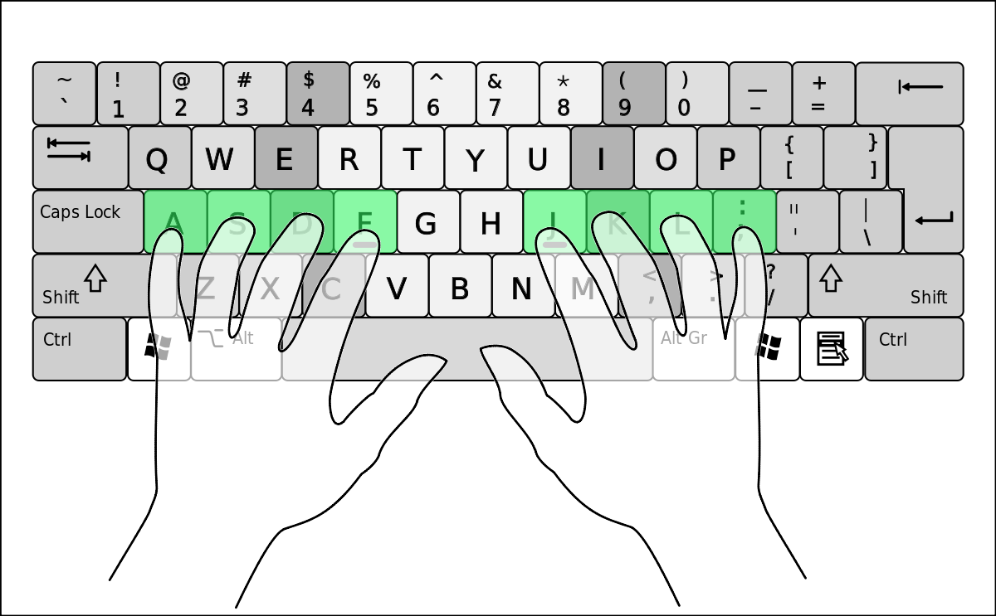
Copyright Wikimedia user Cy21, License: CC A-SA 3.0 Unported

Slide 7
I was surprised that most developers don’t really care about using the computer efficiently.
I know top-rate developers who suck at handling their computers:
They can’t touch-type.
They don’t use any keyboard shortcuts beyond obvious ones like ctrl-z, ctrl-c, ctrl-x and ctrl-v.
They don’t make their own keyboard shortcuts.

Slide 8
Why do developers usually not get excited about optimizing their computer usage?
Inertia: Need to learn a different way to do things, requires upfront investment.
Believing it’s not as important as other skills: Coding skills, design skills, people skills, management skills, etc.
Working on different computers and using different program, not wanting to invest time in optimizing for a program that they could stop using at any time.
“The bottleneck argument.”

Slide 9
“The bottleneck argument”
“As a developer, my typing speed and how efficiently I use my computer are not the bottleneck on my productivity. I spend most of my time thinking about what I’m developing and discussing with colleagues, so cutting down the 20 seconds that it takes me to write a code line to 10 seconds doesn’t make a meaningful contribution to my productivity.”

Slide 10
Why I think The bottleneck argument is wrong
The time saved every day by using the computer more quickly is not the main benefit here.
Most productive part of development is when you’re in the zone, i.e. in deep concentration.
Using the computer quickly lets you stay in the zone longer and be more focused on the problem.

Slide 11
I’ll talk about my personal story of learning to use computers efficiently.
I’ll talk about why nobody talks about using computers efficiently.
And then I’ll talk about how to use computers efficiently.

Slide 12
Things I’ll talk about today that you can do to use your computer more efficiently:
Learn how to touch-type.
Use keyboard shortcuts that are provided by the programs and OS that you use.
Create your own keyboard shortcuts.
Use programs that help you be more productive.
Learn how to replace bad habits with good habits.

Slide 13
How to replace bad habits with good habits
Decide that you’re willing to spend time and effort replacing bad habits with good habits.
Constantly be on the lookout for things you can do more efficiently.
When you revert to the bad habit, stop, go back and do it the right way.
Make exponential memos to practice the good habit.

Slide 14
What are Exponential memos?
They are the best way that I’ve found to ingrain new habits.
Make memos for yourself for 1 hour from now, 2 hours from now, 4 hours… 1,024 hours.
Every time a memo pops up, you practice the activity, even if you don’t need to use it right now.
Every time you want to ingrain a new habit, you create a new set of exponential memos to practice it.

Slide 15
How can I create exponential memos?
Simplest way is to use followupthen.com
Send email to 3hours@fut.io , get an automatic reply in 3 hours. Other time expressions also work:
1100@fut.io
nextwednesday@fut.io
1100-sms@fut.io if you pay for the pro version.
To do exponential memos, send email to multiple recipients: 1hour@fut.io , 2hours@fut.io , 4hours@fut.io , …, 1024hours@fut.io

Slide 16
Things I’ll talk about today that you can do to use your computer more efficiently:
Learn how to touch-type.
Use keyboard shortcuts that are provided by the programs and OS that you use.
Create your own keyboard shortcuts.
Use programs that help you be more productive.
Learn how to replace bad habits with good habits.

Slide 17
Biggest rule: The mouse is the root of all evil.
Anything that can be done with the keyboard, should be done with keyboard.
Developers love CLIs because they’re keyboard-driven, but many don’t know that GUIs can be keyboard-driven too!

Slide 18
Every time you touch the mouse, ask yourself, could I do the same action using the keyboard?
Think of a task that you do every day. Can you do it without using the mouse?
Found something you can’t do with the keyboard? Ask me: ram@rachum.com or ask on superuser.com

Slide 19

I’ve used AutoHotKey to make hotkeys that automate common tasks in Windows.
AutoHotKey is an interpreted language, like Python.
I have mixed feelings about AutoHotKey. There are things that I love it for, and things that I hate it for.

Slide 20
AutoHotKey: what’s good about it
AutoHotKey is brilliant at automating everyday computer tasks:
Define hotkeys
Send text as if typed by user
Move the mouse
Manipulate Windows (Move, resize, maximize, minimize…)
And a lot more…
Manipulate the clipboard
Run programs
Open folders in explorer

Slide 21
AutoHotKey: Simple examples
Hotkey that opens my default notes file in my text editor when pressing Start-N:
#n:: Run, %A_Desktop%\notes.txt
Hotkey that types my email when I press Start-0:
#0:: Send ram@rachum.com
I use these dozens of times every day.

Slide 22
AutoHotKey: A more complex example
Implementing a simple clipboard editor in 11 lines!
#MaxThreadsPerHotkey 2
#!+n::
WinWait, Scratchpad,, 0.001
If ErrorLevel
{
InputBox, Clipboard, Scratchpad,,,,,,,,,%Clipboard%
Return
}
WinActivate, Scratchpad
Return
#MaxThreadsPerHotkey 1

Slide 23
AutoHotKey: what’s bad about it
AutoHotKey’s programming language is a terrible one. It sucks so, fucking, bad.
It’s okay for writing short scripts, but anything with complex logic is a nightmare. It feels like writing a web app in Bash.

Slide 24
Some examples of AUTOHOTKEY’s horribleness
Q: What do you think this line does?
if x = y
A: Makes me never want to program in AutoHotKey.
Q: What do you think this line does?
InputBox, Clipboard, Scratchpad,,,,,,,,,%Clipboard%
A: Makes me want to be in a coma too.

Slide 25
Some productivity software I use
Windows only:
Launchy (launches programs)
Ditto (clipboard manager)
Dexpot (multiple desktops)
Ultramon (multiple taskbars)
UndoClose (re-open windows you just closed)

Slide 26
Some productivity software I use
Cross-OS:
Dropbox
GleeBox (keyboard navigation for Chrome)
F.lux (change monitor colors based on time of day)

Slide 27
Thank you ☺

